Slide 2
Traffic Flow
Lakeview-Fort Oglethorpe High School

Slide 3
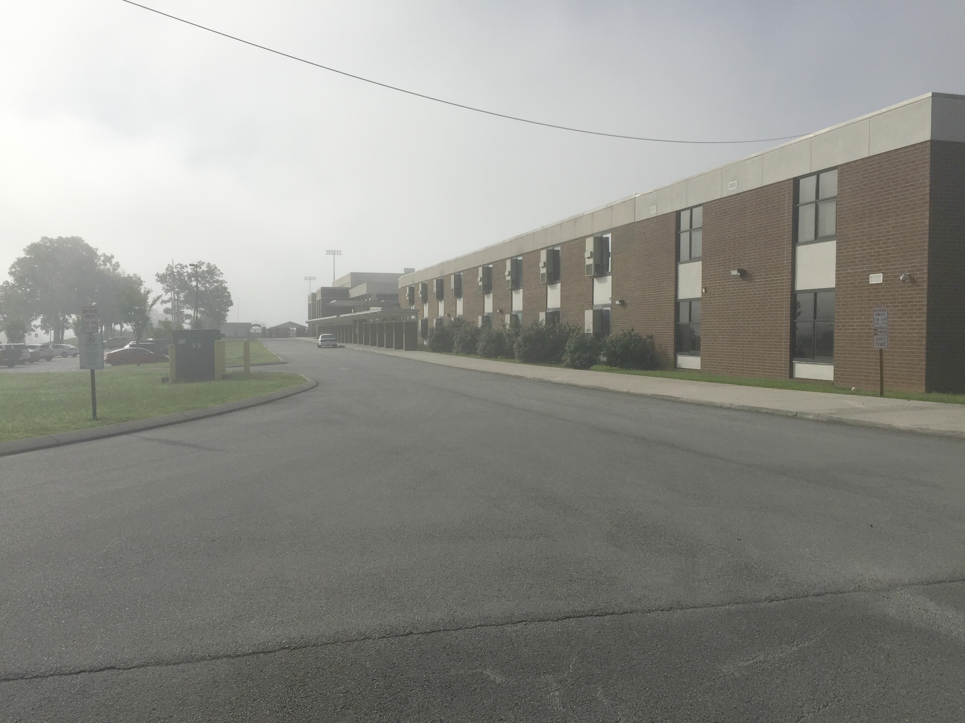
Buses Load and Unload at the Front of the School
No cars should drop off or pick up at the front of the school between 7:00-8:00 or 3:00-4:00. If you are a visitor, please park in the front lot and enter through the front doors to sign in for a visitor’s pass. Do not block the driveway.

Slide 4
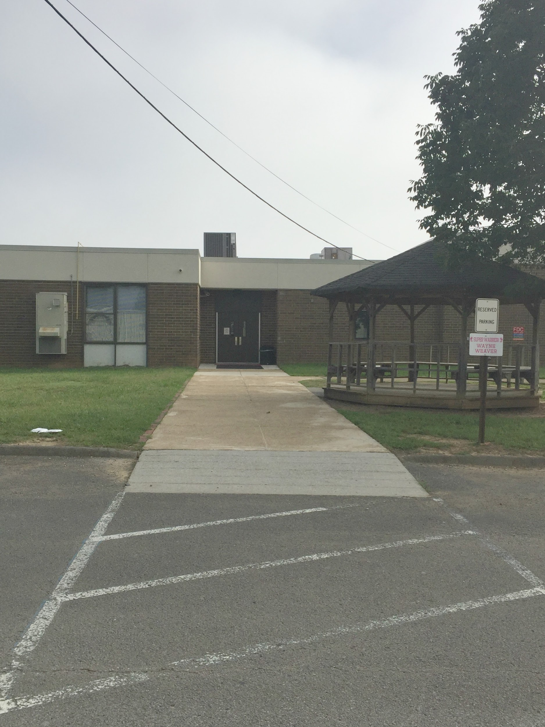
Parent Pick Up and Drop Off
All students must be dropped off and picked up at the back of the school in front of the JROTC building. Students will enter the 500 hall door.

Slide 5
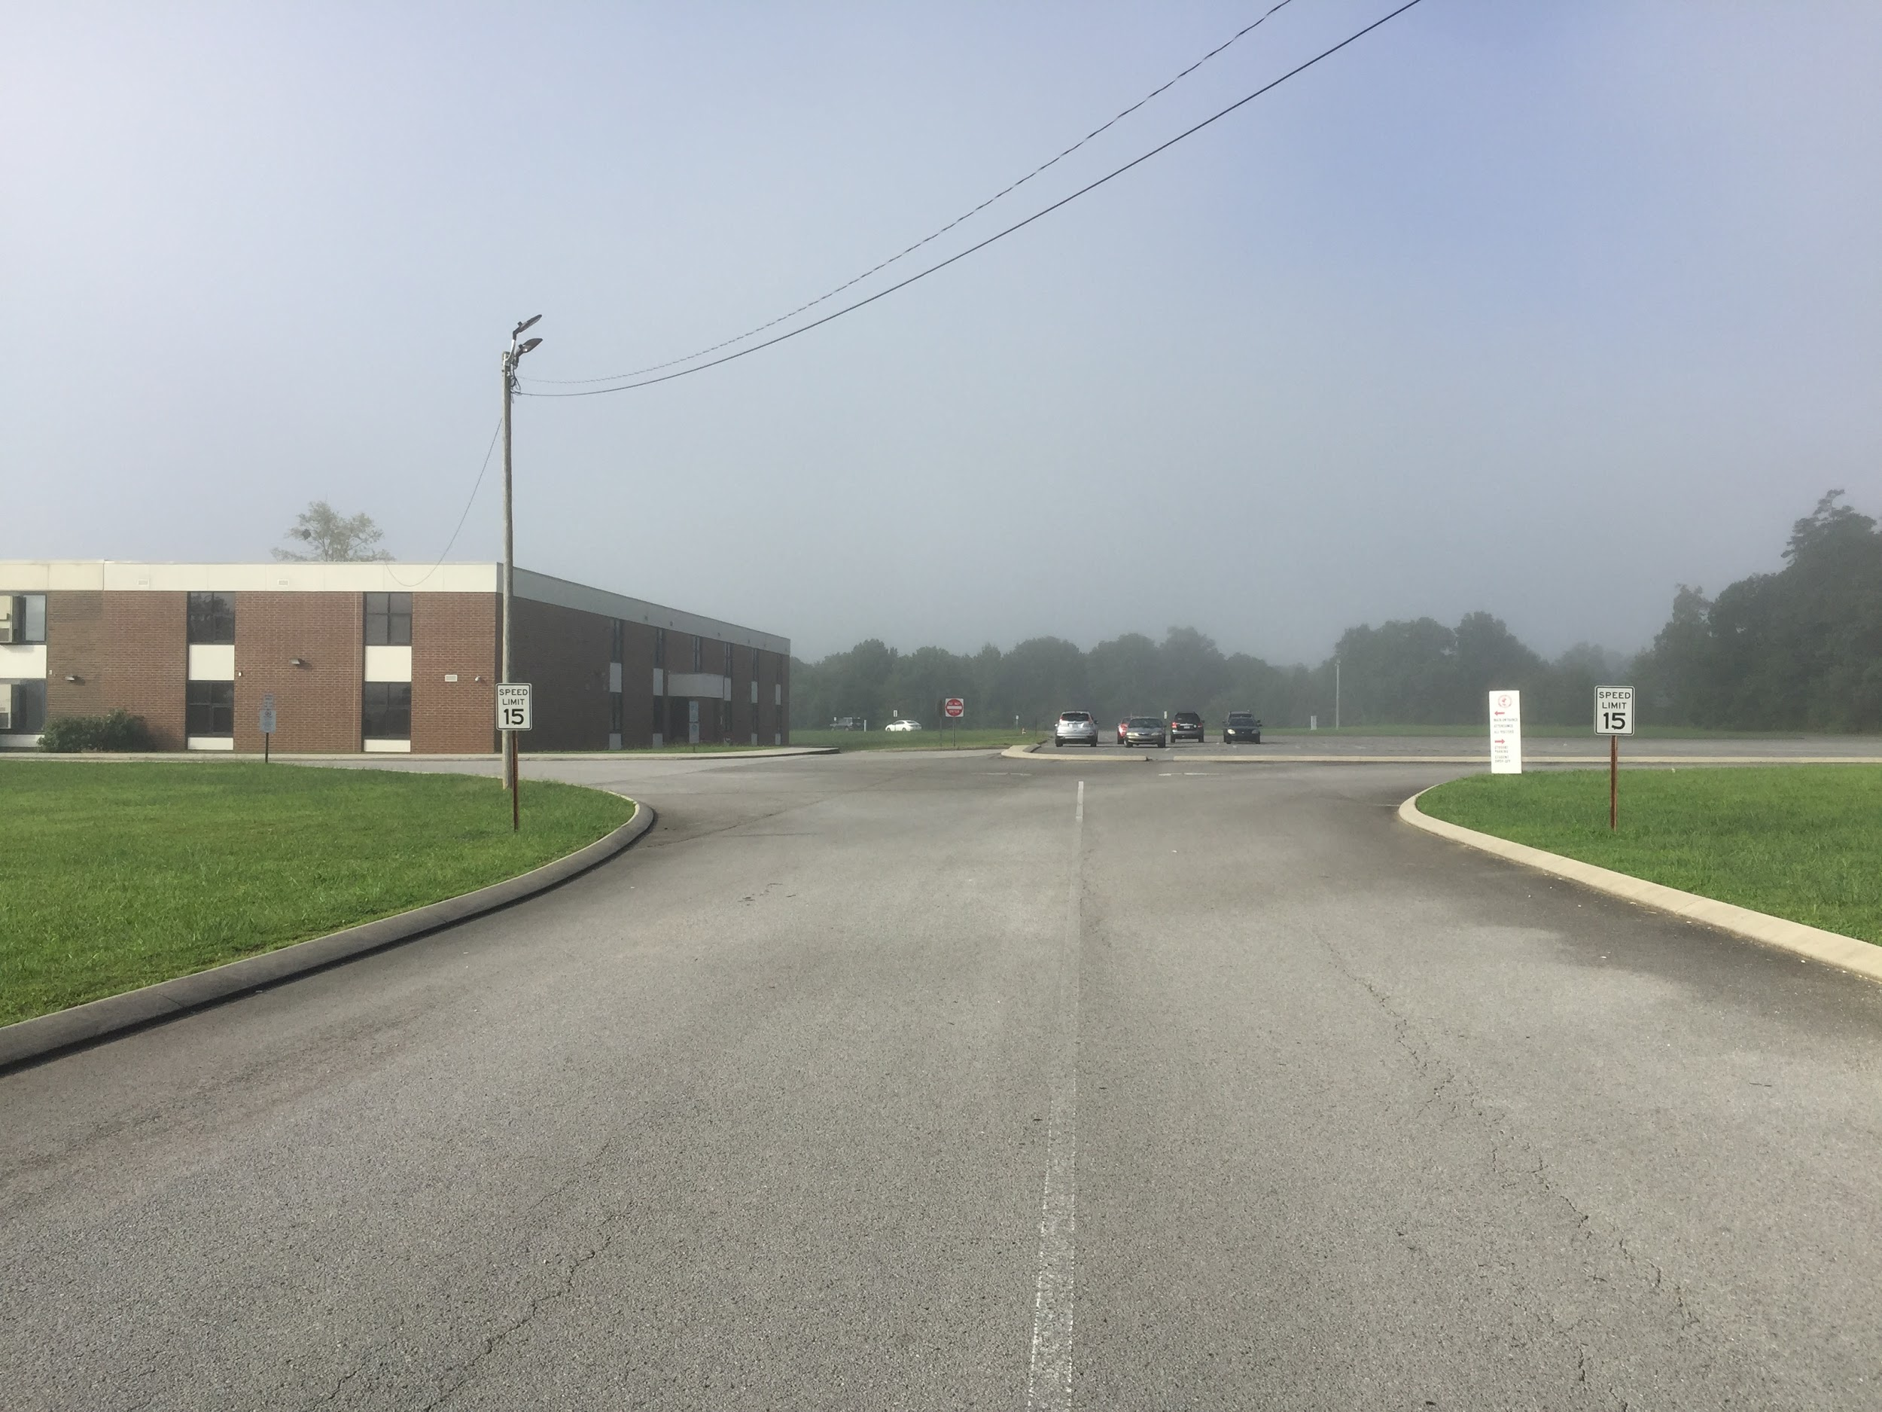
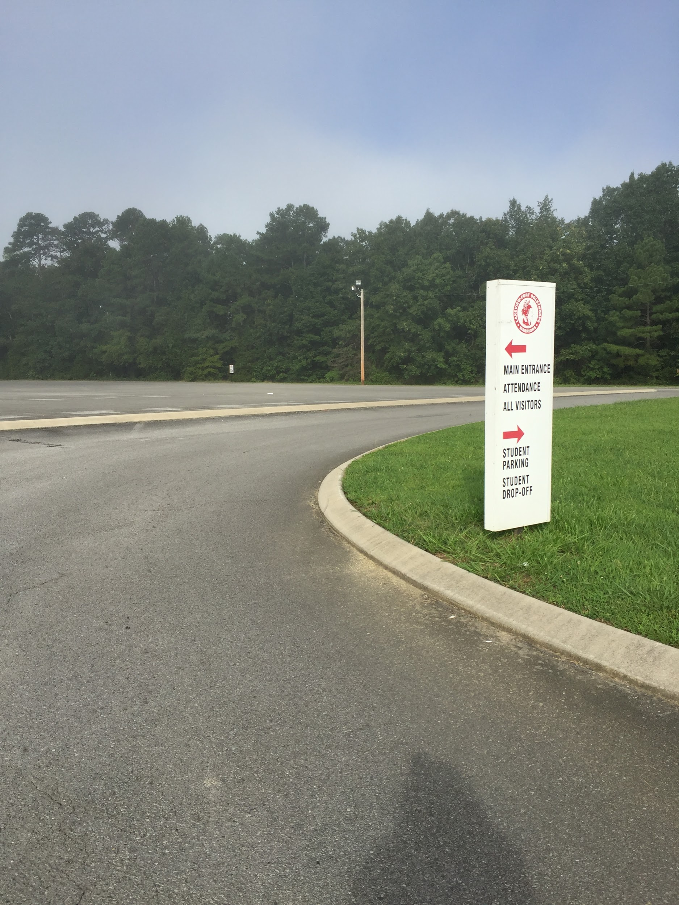
Procedures from Pick Up or Drop Off
Remember traffic flow is one way all the way around the school. If you are picking up or dropping off, veer to the right and stay on the outside perimeter (near the tree line) of the driveway, not the parking lot.

Slide 6
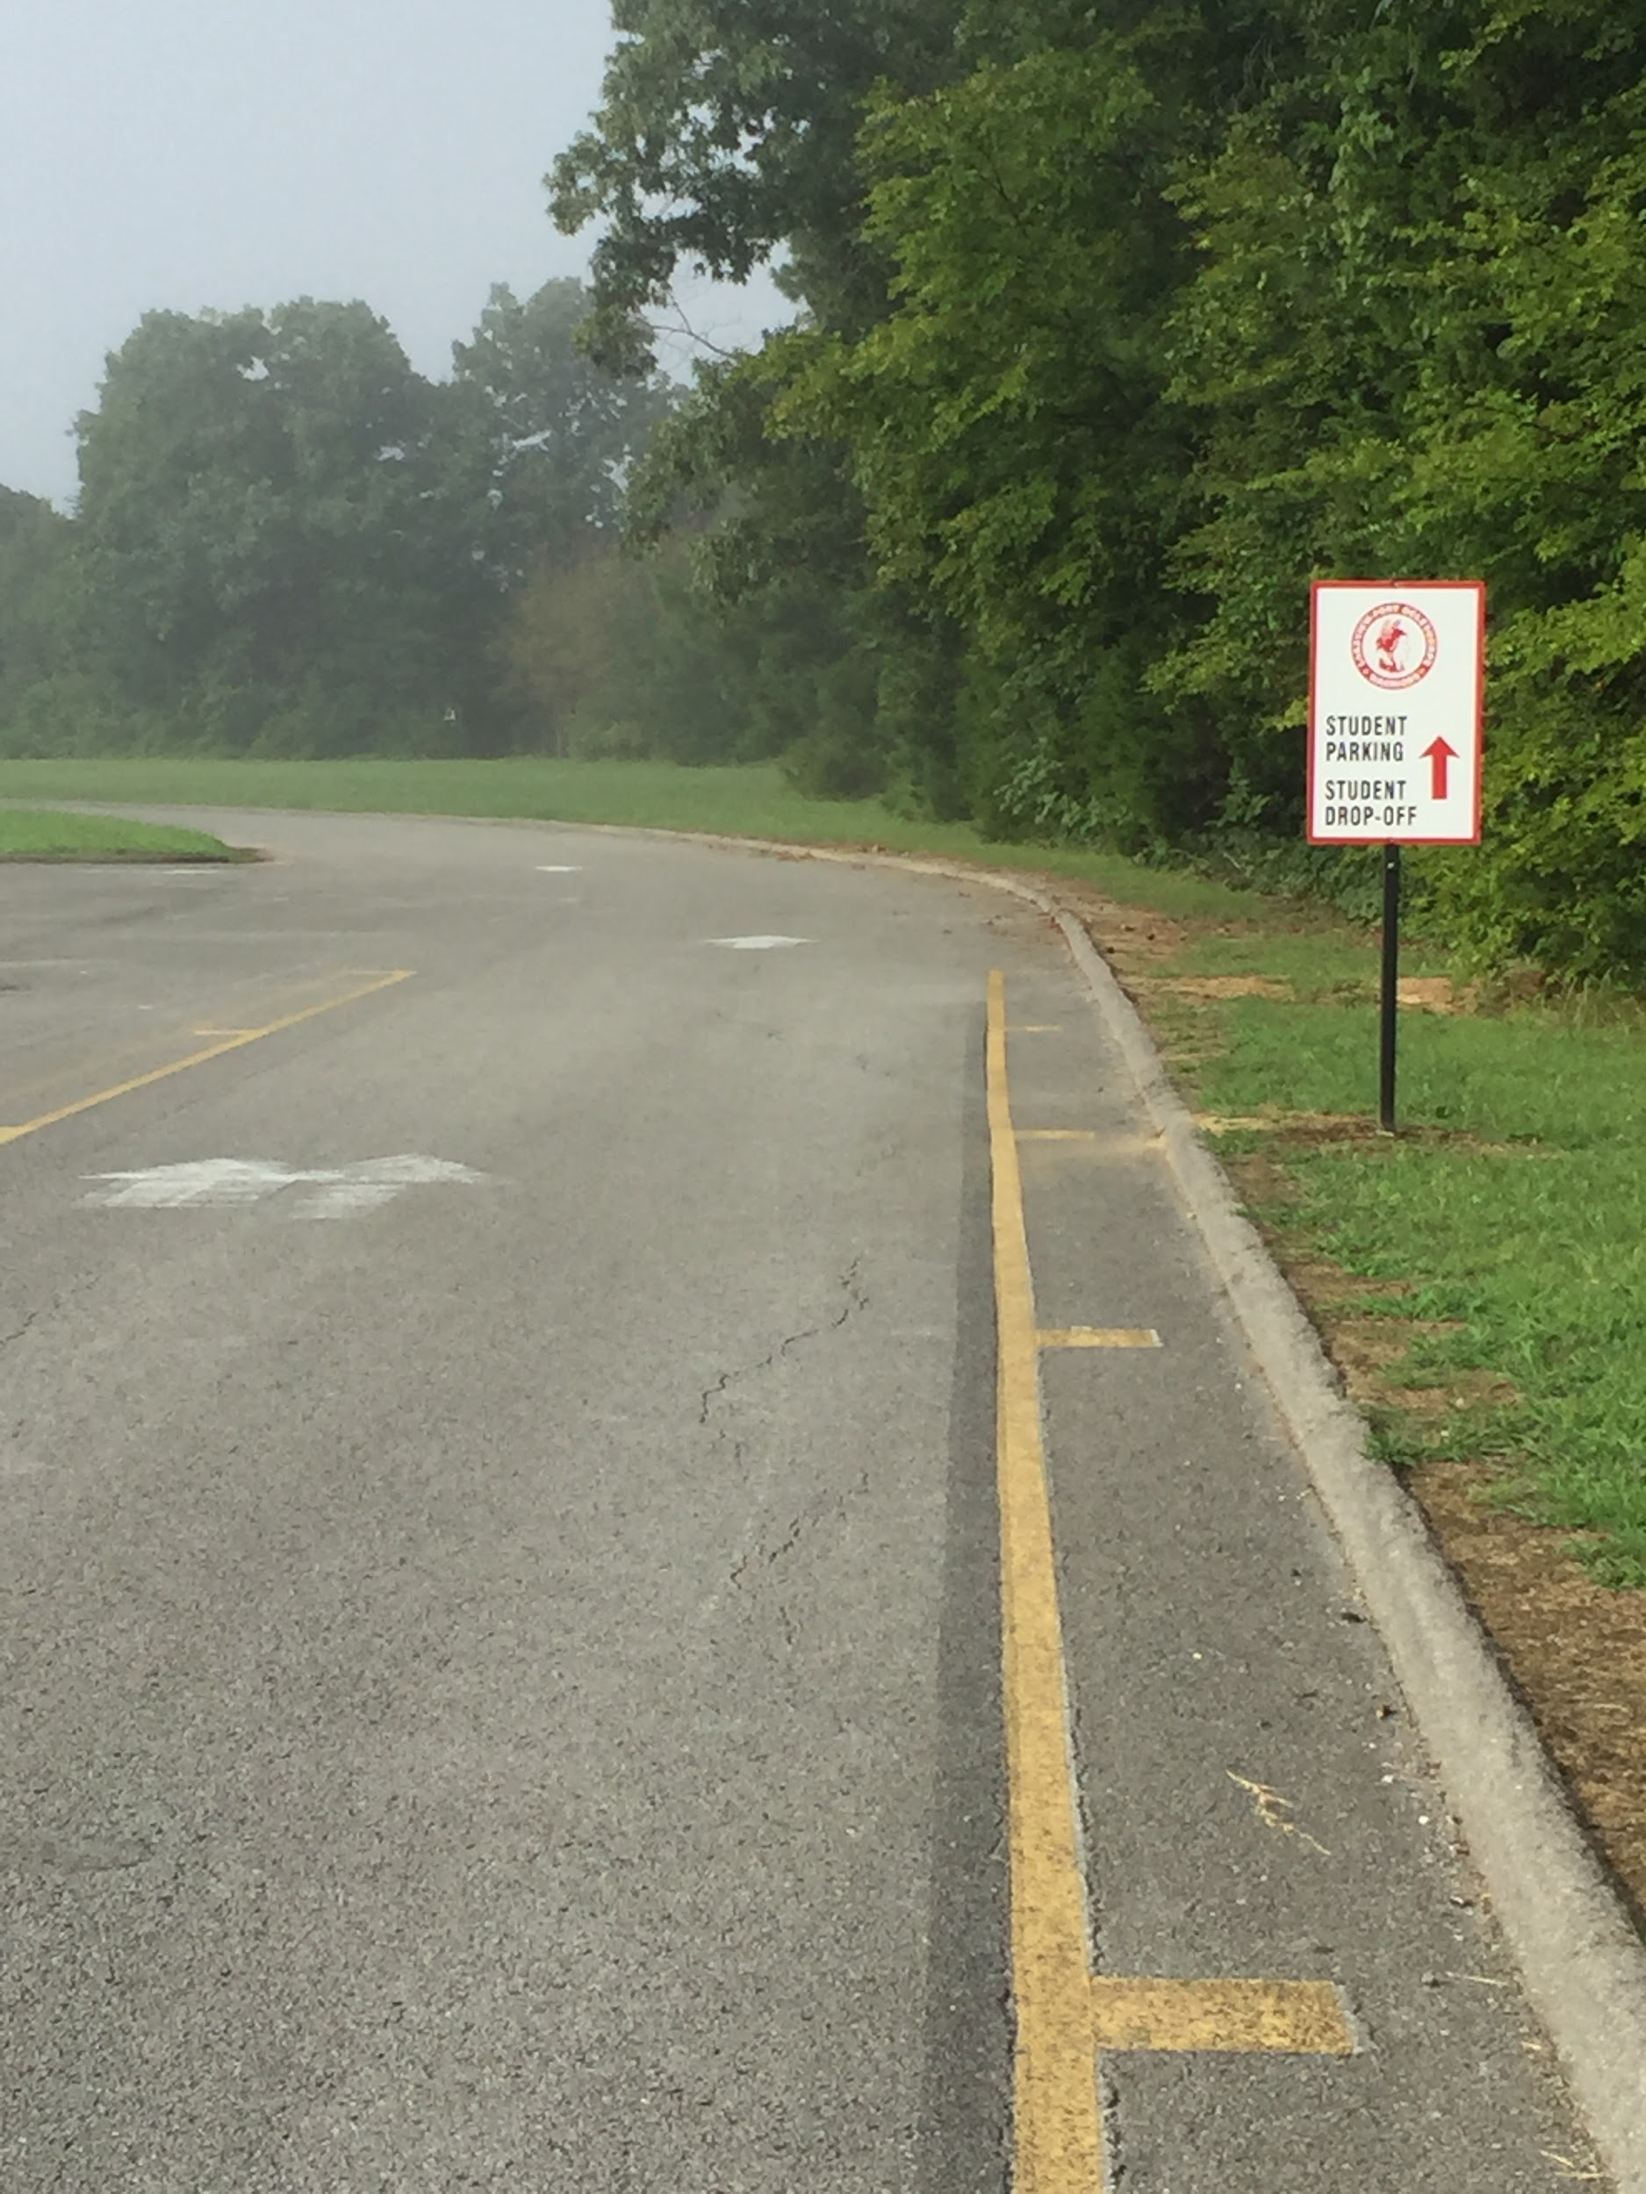
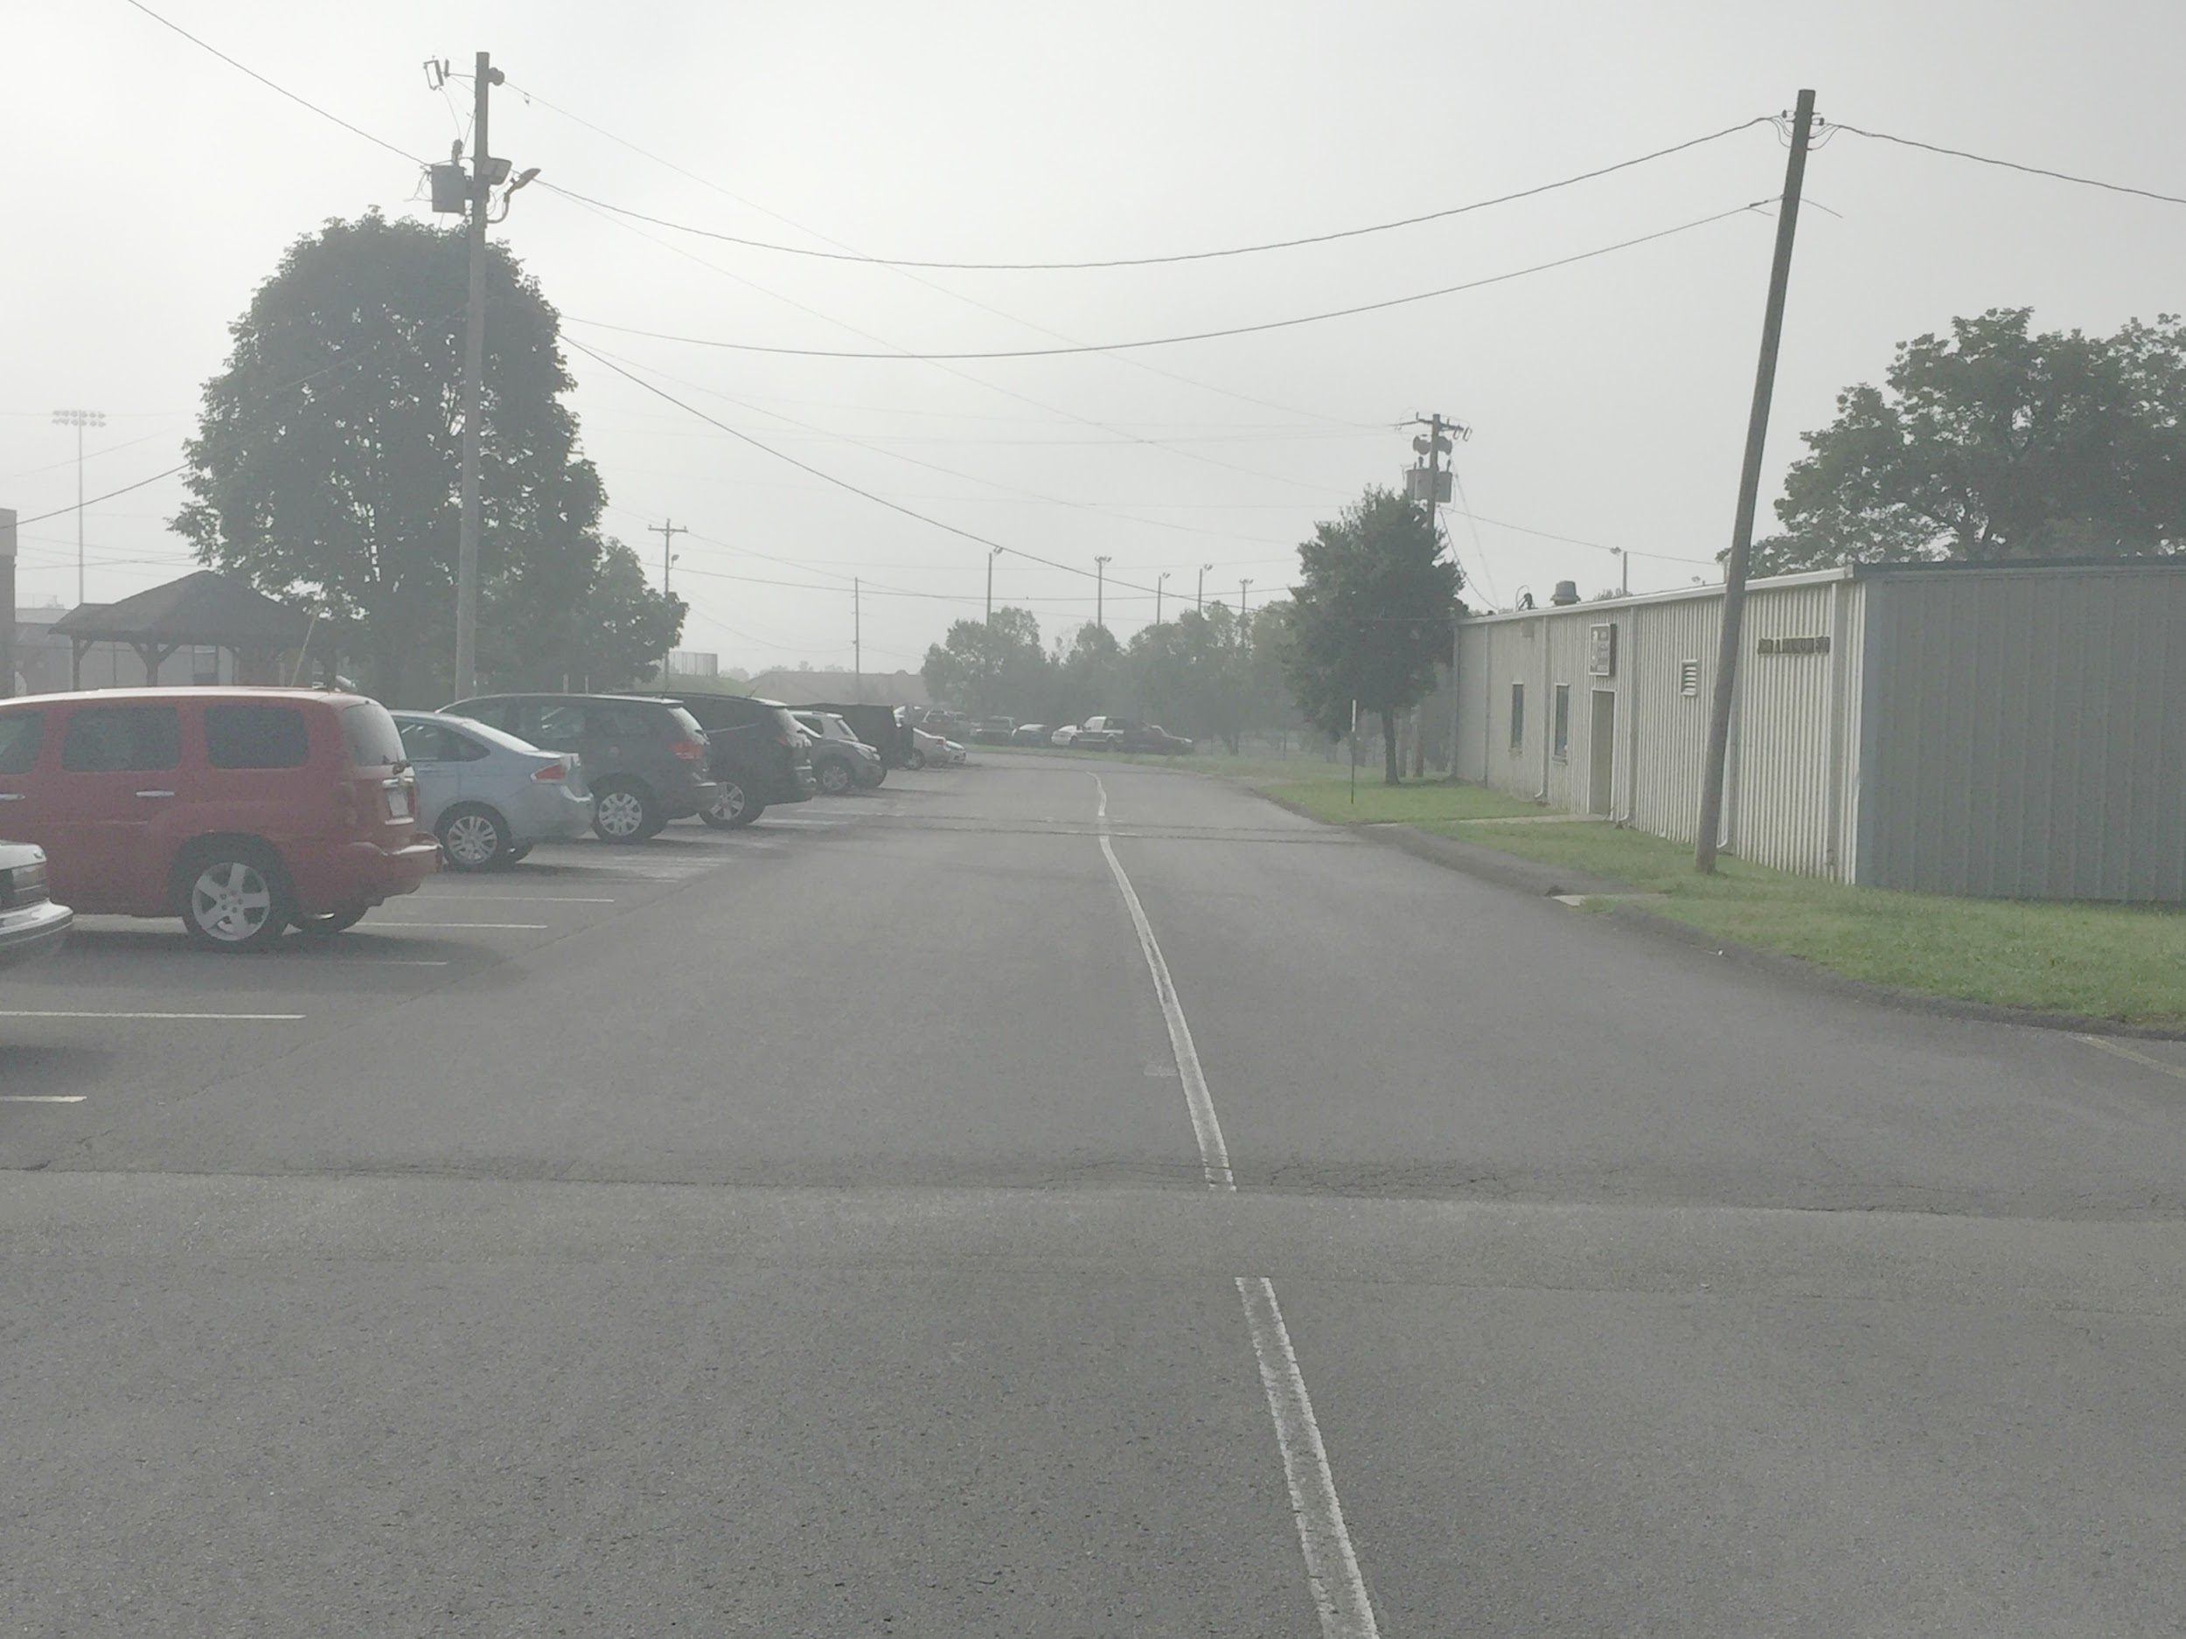
Watch for Students Parking & Walkers Crossing the Driveway. Do Not Pull Through Parking Spaces Or Drop Off Down the First Two Lanes of Parking (no exit).

Slide 7
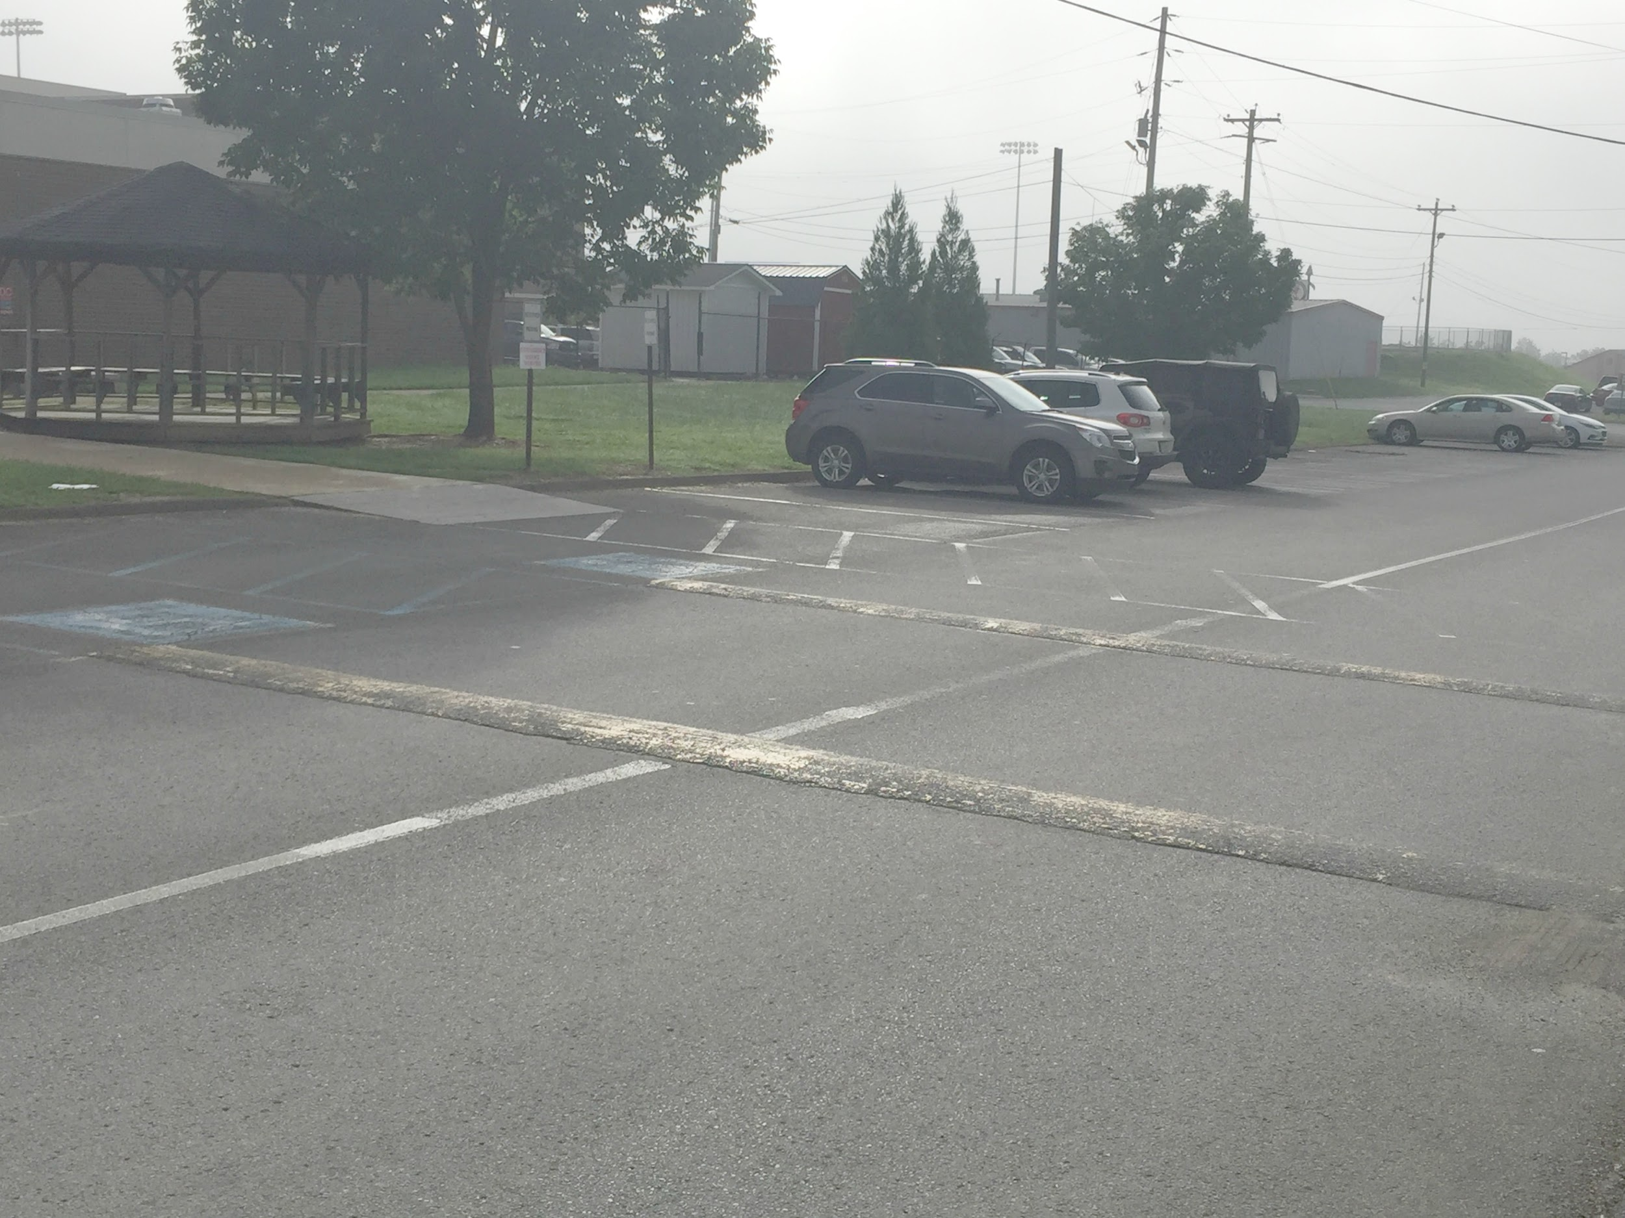
Left Lane Drop Off / Pick Up - Right Lane Through Traffic
Remember for the safety of our students, the left lane is for drop off / pick up and the right lane is for through traffic. Please do not stop in the right lane. Through traffic, please watch for students exiting the vehicle as you slowly pull through. In an effort to move cars quickly through the line, please be sure your student is ready to exit the car when you get to the drop off area. Walkers have the right of way.

Slide 8
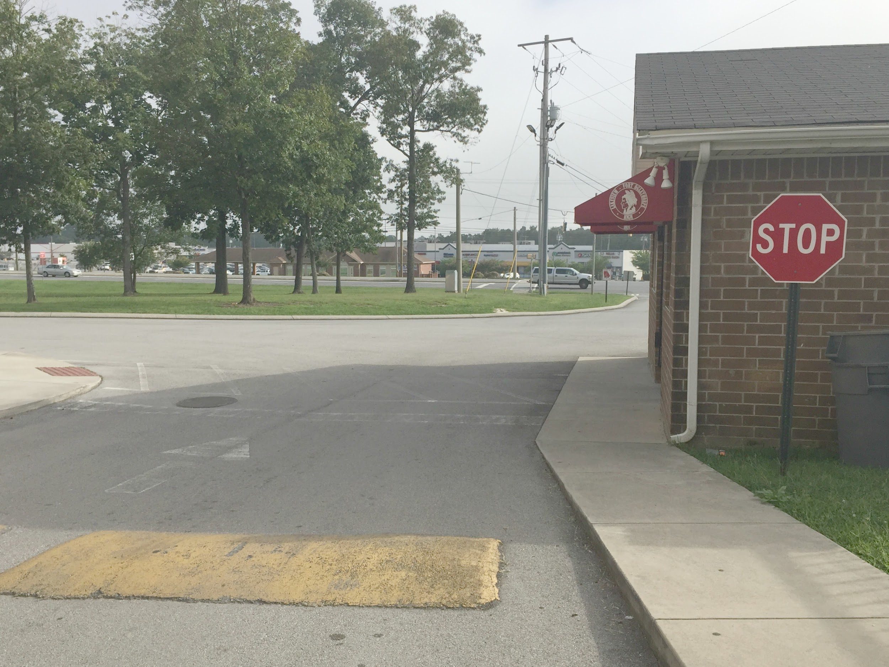
Exiting Campus
Please keep your speed down, as we have students crossing the road from the field house and JROTC building in the mornings and afternoons. Please be aware of the STOP sign at the ticket booth and remember that the buses have the right of way. Please come to a complete stop and then proceed to the red light when it is clear. Budget some extra time during the first few days of school.

